Slide 1
The MGB Alzheimer Therapeutics Program
Ushering in a new era of disease-modifying therapies for Alzheimer disease
Fall 2023

Slide 2
Collective effort over years
The plans presented reflect the tireless efforts of dozens of individuals over many years
  Aducanumab working group → lecanemab working group → ATP
  Weekly meetings for months; committees, logistical teams, multiple institutions, depts
  Clinicians, clinical scientists, pharmacists, radiologists, nursing, administrators, staff, IT
The underlying scientific neurobiological models were pioneered here
The clinical science has been advanced here
Disease-modifying therapies, especially those targeting amyloid, has grown from a vision to a plan to now a reality
This is a joyful moment – there is now an option for slowing down the progression of Alzheimer disease
This is a moment of intense focus; ensuring success requires careful systems to ensure a safe, efficacious, and equitable delivery

Slide 3
Lecanemab (Leqembi)

Slide 4
Outline
Lecanemab (Leqembi)
Dosing and administration
Clinical efficacy
Side effects: ARIA
Alzheimer Therapeutics Program (ATP)
Shared care model
Requirements before referring
How to refer in Epic
Emergency Department considerations

Slide 5
Lecanemab
Monoclonal antibody given as IV infusion every two weeks to remove amyloid plaques
  Targets Ab oligomers and protofibrils, which are highly toxic
  Amyloid hypothesis – that amyloid toxicity is central to the pathophysiology of AD
FDA approved for treating mild cognitive impairment or mild dementia due to Alzheimer disease
  Mild cognitive impairment (MCI): abnormal cognitive testing results, but full independence in instrumental (e.g., household tasks; finances) and basic (e.g., bathing, dressing) activities of daily living (ADLs)
  Mild dementia: abnormal cognitive testing results, some dependence in instrumental ADLs, but full independence in basic ADLs
    Patients with any loss of independence in basic ADLs due to cognitive impairment have moderate dementia and are not eligible for lecanemab
  due to Alzheimer disease: evidence of amyloid plaques in their brain by CSF biomarkers (lumbar puncture) or by amyloid PET scan

Slide 6
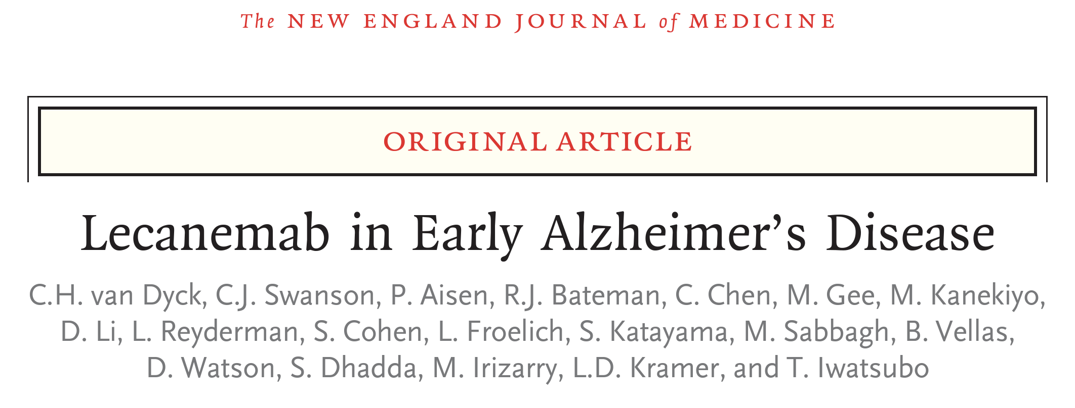
Lecanemab Phase 3 Trial: CLARITY AD
Large, double-blind, placebo-controlled study
Who: 1766 pts across 245 sites, ~900 received lecanemab
Diagnosis: mild cognitive impairment or mild dementia
Cognitive: MMSE >21, with memory loss
Function: CDR global 0.5-1.0
Biological: positive amyloid-PET scan or CSF markers
Excluded: people with bleeding in the brain, others
  Allowed anticoagulant use
Followed for 18 months

Slide 7
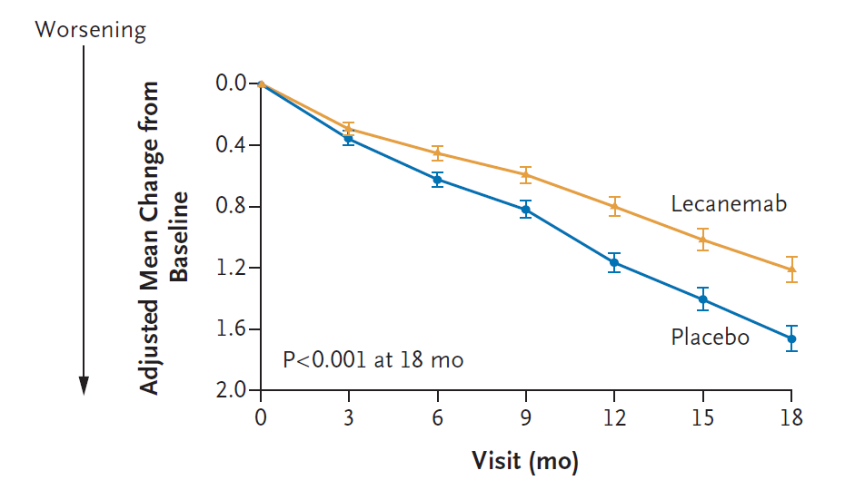
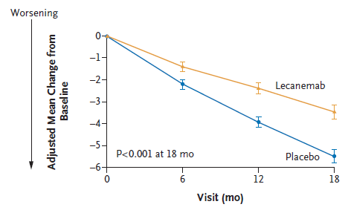
Lecanemab: Phase 3 Study Results
Placebo and lecanemab groups declined cognitively and functionally, but lecanemab group declined ~27% less over 18 months
Clinical Dementia Rating – Sum of Boxes (primary outcome):
Activities of daily living (ADCS-MCI-ADL, secondary outcome):
Van Dyck et al. (2023) New Engl J Med 388:9-21.

Slide 8
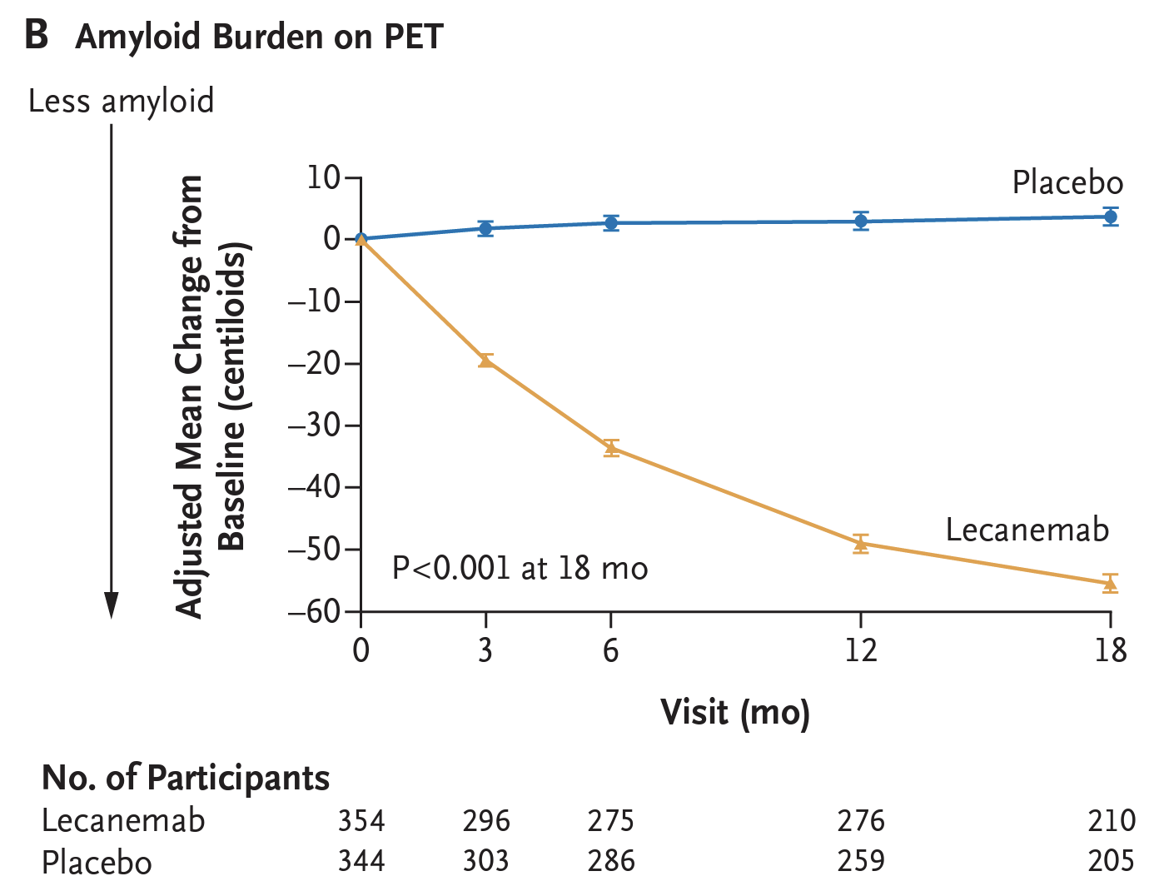
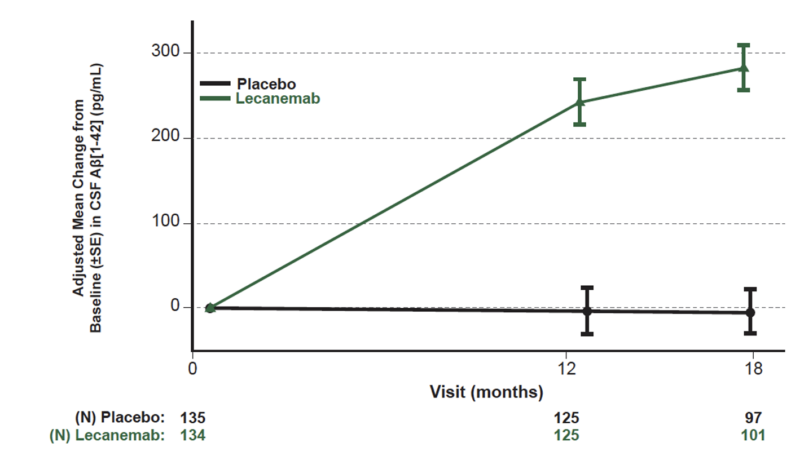
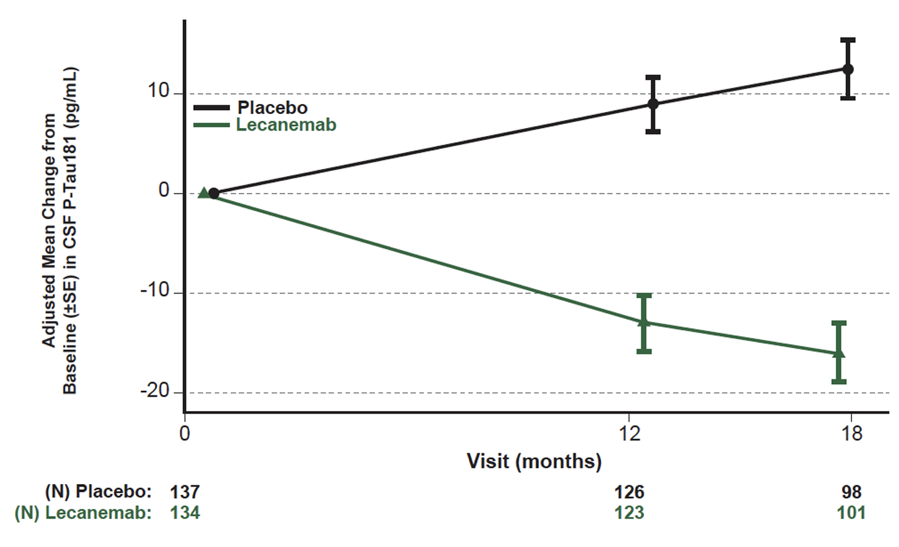
Lecanemab: Phase 3 Study Results
Lecanemab removes amyloid effectively (PET)
Lecanemab improved biomarker profiles in CSF and blood
  AD-specific: total and phosphorylated tau
  Degenerative markers - neurogranin

Slide 9
Lecanemab: Amyloid Related Imaging Abnormalities (ARIA)
Focal areas of cerebral edema (ARAI-E) and associated microhemorrhages (ARIA-H) occurring in patients on lecanemab
Occurred in 13% of all lecanemab-treated clinical trial patients
  Highest risk in first 3-6 months
Mostly asymptomatic (>70% of ARIA)
Case reports of fatal or debilitating injury (risk <1%)
Risk factors for ARIA:
  Pre-treatment brain microhemorrhages (visible on MRI)
  Having the ApoE gene ε4 allele (homozygotes > heterozygotes > non-carriers)
  Therapeutic anticoagulation
ARIA requires MRI monitoring

Slide 10
Alzheimer Therapeutic Program

Slide 11
Alzheimer Therapeutics Program (ATP) Overview
Shared provider model akin to anticoagulation management service (similar to a “Coumadin clinic”)
  Responsible for administration and safety monitoring of lecanemab
  Not responsible for other aspects of dementia care (other memory medications, psychiatric care, community services, etc.)
    --Referring provider remains main resource for patient and family; ATP always available for lecanemab-specific concerns
    --Typical cognitive and behavioral neurology referrals remain available for comprehensive cognitive evaluations
The ATP has harmonized procedures across MGB, but BWH and MGH have separate referrals and physician pools (for now)
Key Objectives
Screening and Eligibility Determination
~400 currently treated MGB patients would meet criteria for lecanemab treatment, plus ~600 new patients with early AD evaluated annually. The process for determining drug eligibility includes a focused history and physical exam, standardized cognitive screening assessments, brain MRI, Alzheimer-specific biomarker testing (e.g., CSF testing or amyloid-PET), and APOE genetic testing.
Safety Monitoring and Triage
A critical function of the ATP clinic is drug safety monitoring with neuroimaging and clinical assessments. Patients will be triaged and offered urgent / emergent visits to address any possible side effects.
Coordinate the Work of Interdisciplinary Provider Teams
The ATP will be a collaboration led by the Departments of Neurology at Massachusetts General Hospital (MGH) and Brigham and Women’s Hospital (BWH), with appropriate partnerships with Geriatric Psychiatry, Pharmacy, Radiology, Nursing (Infusion), and the Mind & Memory Care Program at MGB institutions; and many allied clinicians across MGB.
Collect Clinical Data
To support quality improvement efforts and clinical research, clinical data will be collected, monitored and tracked for the ATP clinic. The ATP clinic will also contribute to a national registry to better understand the biological and clinical impact of anti-Alzheimer drugs. As future AD drugs come to market in the short term, this will be critical to the successful deployment of these drugs as well.

Slide 12
Shared Service Model
On/Off call model - 1 week on
On-call provider takes care of much of the ATP activities:
  Sees patients in clinic (starting out with 4-hour session per week)
  Triages incoming referrals
  Orders pending eligibility studies (CSF, APOE, etc)
  Reviews MRIs for ARIA
  Reviews and addresses patient messages/calls/emails
  Makes decisions if/when to pause therapy plans based on MRI/symptoms
  24-7 pager coverage for emergencies
Passes off active issues to incoming on-call provider
Supported by a growing administrative team

Slide 13
Requirements for ATP referral
1. Patient has mild cognitive impairment or mild dementia
  i.e., cognitive impairment does not affect basic activities of daily living (bathing, dressing, eating, toileting, etc.)
2. Brief cognitive screening test within the past 6 months
  Mini-mental State Exam (MMSE), Montreal Cognitive Assessment (MoCA), or St. Louis University Mental Assessment (SLUMS)
  Mini-cog not sufficient
3. Brain MRI within the past year
4. Blood tests within the past 6 months: CBC, CMP, PT-INR, PTT, TSH, Vitamin B12
5. For now, full-strength anticoagulation is a strict contraindication for lecanemab
6. A continued follow-up plan with the referring provider
Alzheimer disease biomarkers (lumbar puncture or amyloid PET) and ApoE genotyping will be handled by the ATP, but can be done in advance if referring provider is comfortable
When in doubt, please ask: mgbatp@mgb.org

Slide 14
ATP lecanemab eligibility checklist
ATP clinicians will review available referral information to determine if the patient may meet eligibility criteria, and what workup remains within the ATP:
Clinical diagnosis of AD-spectrum syndrome at severity of MCI or mild dementia
MoCA 15 or greater, MMSE 22 or greater, SLUMS 16 or greater within 6 months of referral (exceptions may be considered)
Does not have clinical diagnosis of Lewy body dementia or frontotemporal dementia-spectrum syndrome
Is not on full-strength anticoagulation or immunosuppression
Does not have other poorly controlled chronic medical, neurological, or psychiatric conditions
Able to comply with infusion visits every 2 weeks
CMP, B12, TSH, CBC, PT, PTT within 6 months of referral without abnormalities requiring further investigation
MRI brain within 12 months of referral without exclusionary findings (>4 microbleeds, severe small vessel disease, large vessel infarcts)
Elevated p-tau181/Abeta42 (Mayo Clinic labs), Abeta42/p-tau - 0.0105(t-tau) < 3.694 (Athena ADMark), or amyloid PET suggesting elevated brain amyloid
APOE genotyping
Challenging cases will be reviewed by the ATP’s Plaque and Tangle Board (similar to an oncology tumor board)

Slide 15
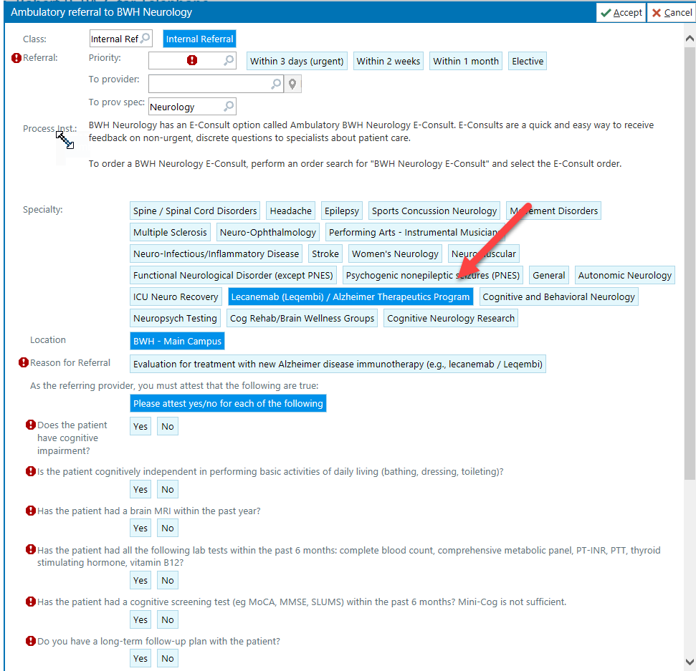
How to refer in Epic

Slide 16
After referral
ATP will screen chart and then contact patient
  May contact referring provider instead if more workup is required before referral or if there is a contraindication from chart review
Up to three ATP visits before starting lecanemab:
  Intake and eligibility
    Obtaining Alzheimer disease biomarkers (spinal fluid)
  Discussion of biomarker results, counseling and ordering genetic testing (ApoE)
  Review of ApoE; prescribing lecanemab
Lecanemab infusions at MGB sites every two weeks
Three additional safety monitoring MRIs within the first six months (plus more PRN)

Slide 17
Emergency Department Considerations
Acute stroke:
Thrombolysis (tPA, Tenecteplase) strictly contraindicated within 3 months of lecanemab therapy
No contraindications to thrombectomy
No contraindications to antiplatelet therapy
  Please discuss initiation of anticoagulation in patients on lecanemab with ATP
Suspected severe ARIA:
MRI T2 FLAIR hyperintensity >10 cm associated with gyral swelling, sulcal effacement
Risk of intracerebral hemorrhage, seizure, coma
Treat with IV methylprednisolone 1 g daily for 5 days followed by oral taper
Consider ICU admission, continuous EEG monitoring
Protocol in Ellucid

Slide 18
Pitfalls … and opportunities
Pitfalls
Will demand outstrip our capacity?
  Neurologists/PCP may be uncomfortable prescribing, also neuroradiologists for ARIA
  Eligibility screening is resource intensive (CSF, cog assessments, genetic counseling)
  Safety monitoring is resource intensive (e.g., multiple MRIs, urgent visit availability)
What happens to patients who have cognitive decline but are not eligible?
  Increasing demand on our longitudinal services
Protocols to ensure safety in preventing ARIA/side effects
  Treatment plans, 24-7 pager, open lines of communication
Opportunities
Can we break free from siloed care and coordinate better?
Subcutaneous formulations, combination therapy, prevention (AHEAD)?
Opportunities for research engagement; national registry

Slide 19
Gratitude and Optimism
The progresses in the clinical science of AD come from the collective efforts of many individuals
  Researchers, clinicians
  Public investment, private enterprise, philanthropy
  Patients, research participants, and their families
This is a start, but there is much, much more work to do

Slide 20
Questions?
Pagers:
BWH: 31439
MGH: 25997
Email: mgbatp@mgb.org

