Slide 1
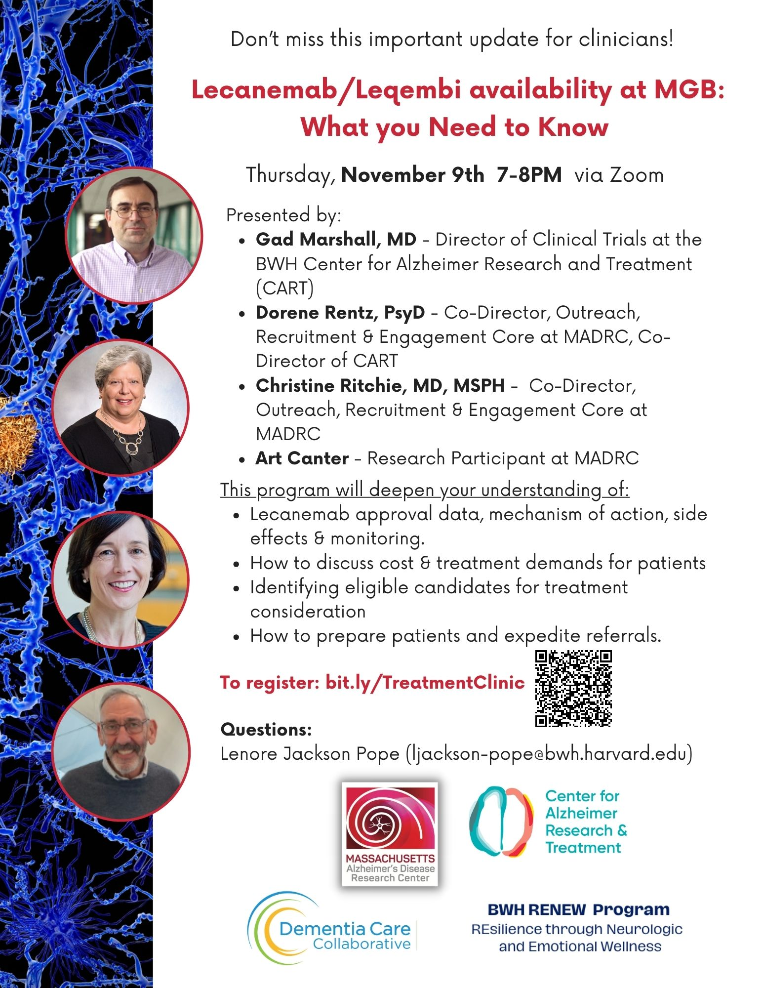
Welcome! - We'll start the program soon.
Please note, this program is intended for a professional audience. We will be hosting another version for the general public on December 1st at noon.
For details, please visit: madrc.org/events/
Tonight’s Panel:
* Gad Marshall, MD – Director of Clinical Trials at the BWH Center for Alzheimer Research and Treatment (CART)
* Dorene Rentz, PsyD – Co-Director, Outreach, Recruitment & Engagement Core at MADRC, Co-Director of CART
* Christine Ritchie, MD, MSPH – Co-Director, Outreach, Recruitment & Engagement Core at MADRC
• Mike Erkkinen, MD – Director BWH Division of Cognitive & Behavioral Neurology
• John Dickson, MD, PhD – Neurologist, MGH Memory Disorders Division
* Art Canter – Research Participant at MADRC
WWW.MADRC.ORG
1

Slide 2
This program is hosted by the Massachusetts
Alzheimer’s Disease Research Center (MADRC) –
Outreach, Recruitment & Engagement Core.
We are grateful to the following groups for
co-sponsoring this event:
BWH Center for Brain/Mind Medicine
MGH Memory Disorders Division
WWW.MADRC.ORG
1

Slide 3
WWW.MADRC.ORG
1

Slide 4
WWW.MADRC.ORG
1

Slide 5
WWW.MADRC.ORG
1

Slide 6
WWW.MADRC.ORG
1

Slide 7
WWW.MADRC.ORG
1

Slide 8
WWW.MADRC.ORG
1

Slide 9
WWW.MADRC.ORG
1

Slide 10
WWW.MADRC.ORG
1

Slide 11
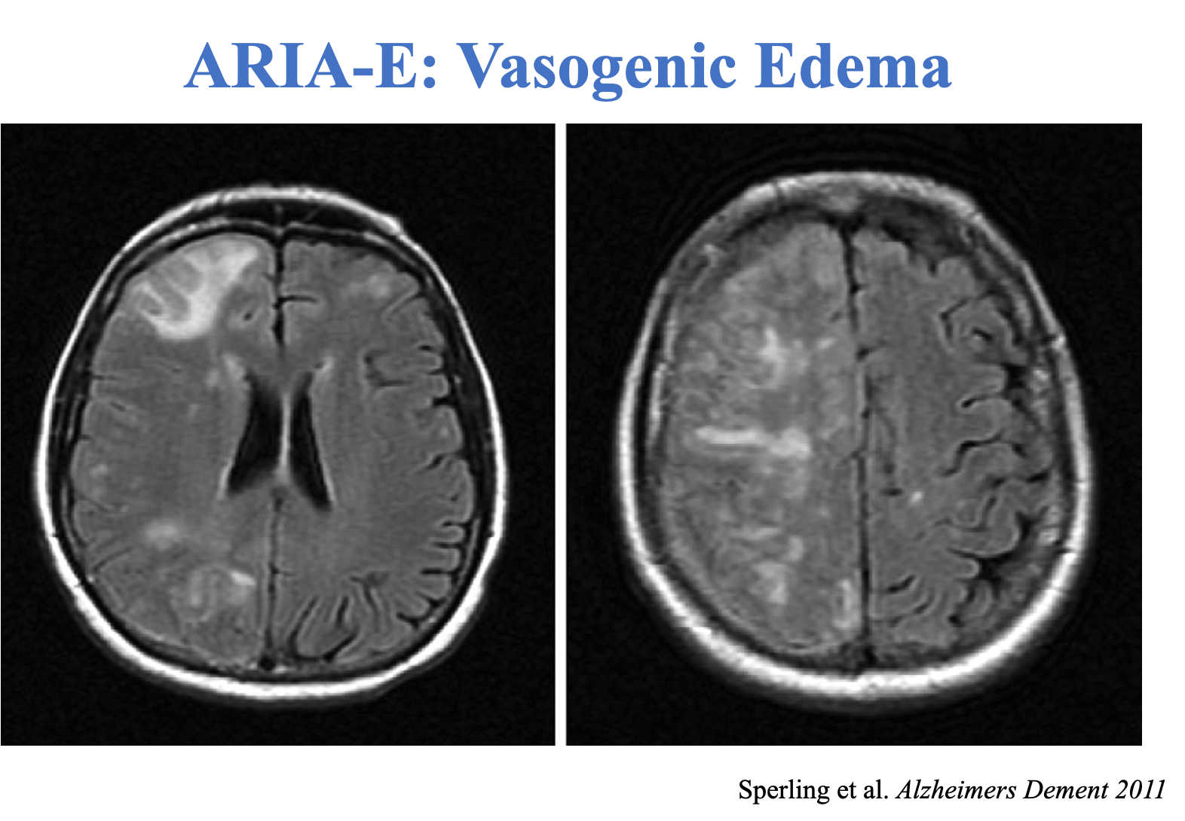
WWW.MADRC.ORG
1

Slide 12
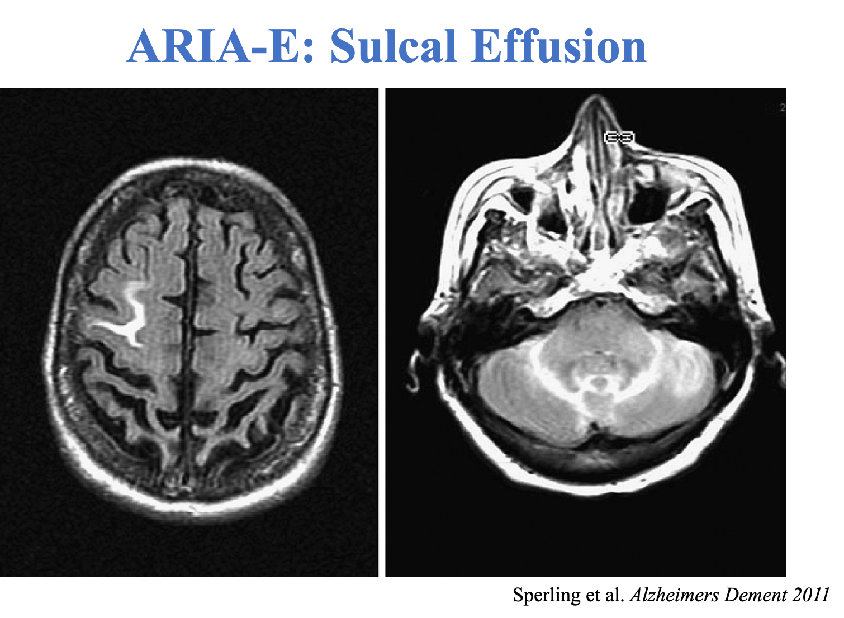
WWW.MADRC.ORG
1

Slide 13
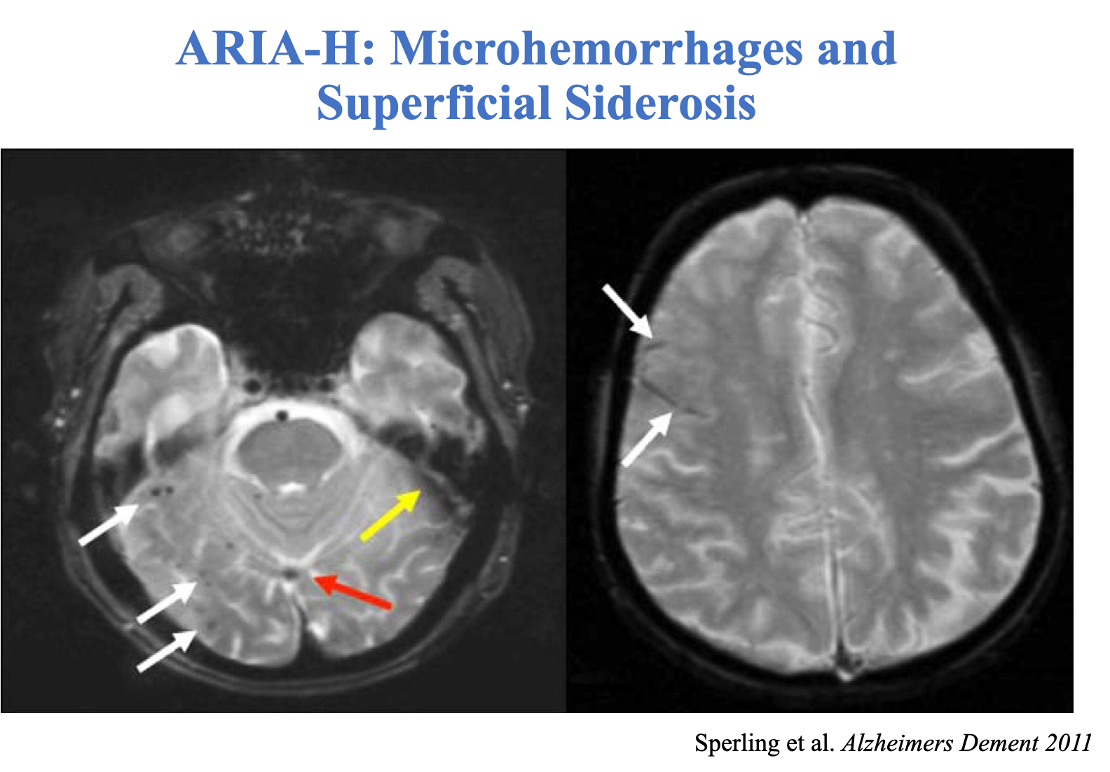
WWW.MADRC.ORG
1

Slide 14
WWW.MADRC.ORG
1

Slide 15
WWW.MADRC.ORG
1

Slide 16
WWW.MADRC.ORG
1

Slide 17
WWW.MADRC.ORG
1

Slide 18
WWW.MADRC.ORG
1

Slide 19
WWW.MADRC.ORG
1

Slide 20
WWW.MADRC.ORG
1

Slide 21
WWW.MADRC.ORG
1

Slide 22
A Family Members’ Perspective
WWW.MADRC.ORG
1

Slide 23
WWW.MADRC.ORG
1

Slide 24
Mike Erkkinen, MD – Director BWH Division of Cognitive & Behavioral Neurology
John Dickson, MD, PhD – Neurologist, MGH Memory Disorders Division
WWW.MADRC.ORG
1

Slide 25
WWW.MADRC.ORG
1

Slide 26
WWW.MADRC.ORG
1

Slide 27
WWW.MADRC.ORG
1

Slide 28
WWW.MADRC.ORG
1

Slide 29
WWW.MADRC.ORG
1

Slide 30
WWW.MADRC.ORG
1

Slide 31
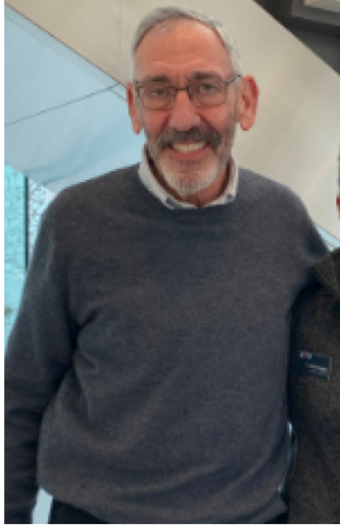
A Research Participants’ Perspective
Art Canter
WWW.MADRC.ORG
1

Slide 32
We value your feedback. Please take 3 minutes to respond to our 5 question, post-event survey.
The link will be emailed to all registrants shortly.
WWW.MADRC.ORG
1

Slide 33
Please visit the MADRC website for more
helpful resources and information:
WWW.MADRC.ORG
WWW.MADRC.ORG
1

Slide 34
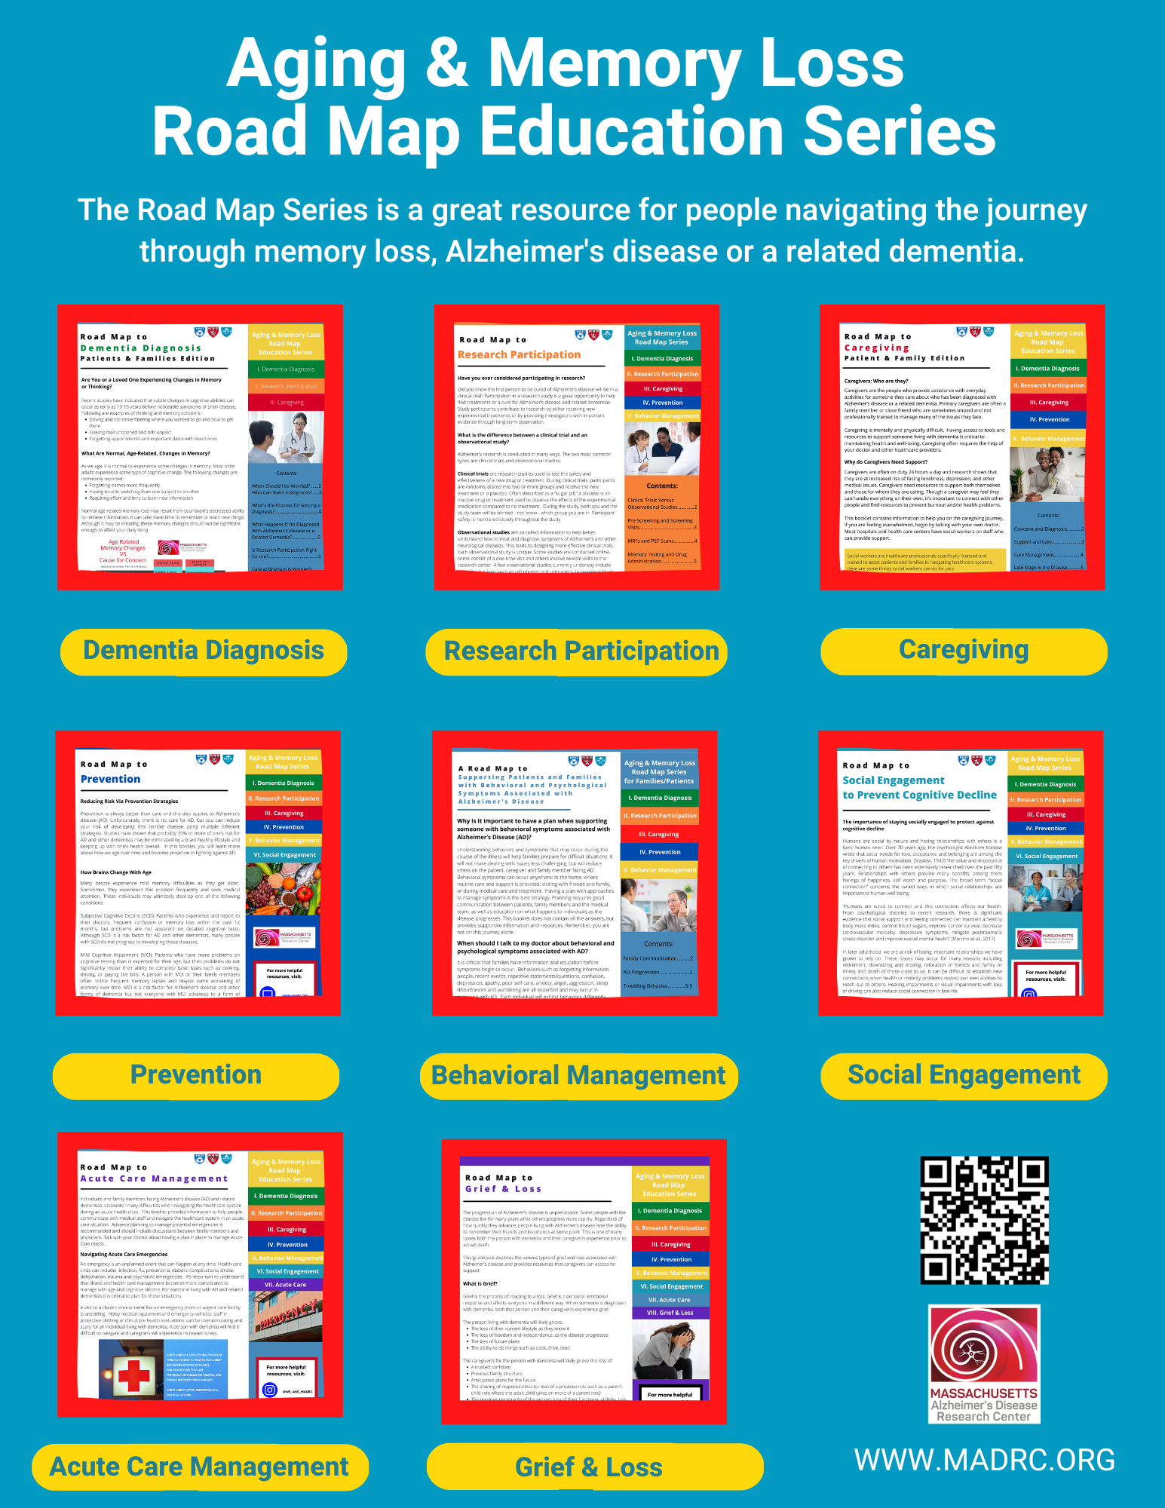
WWW.MADRC.ORG
1

Slide 35
If you have questions or need additional information:
Email: bwhcognitiveneurology@bwh.harvard.edu
Call: 617-278-0600
WWW.MADRC.ORG
1

