Slide 1
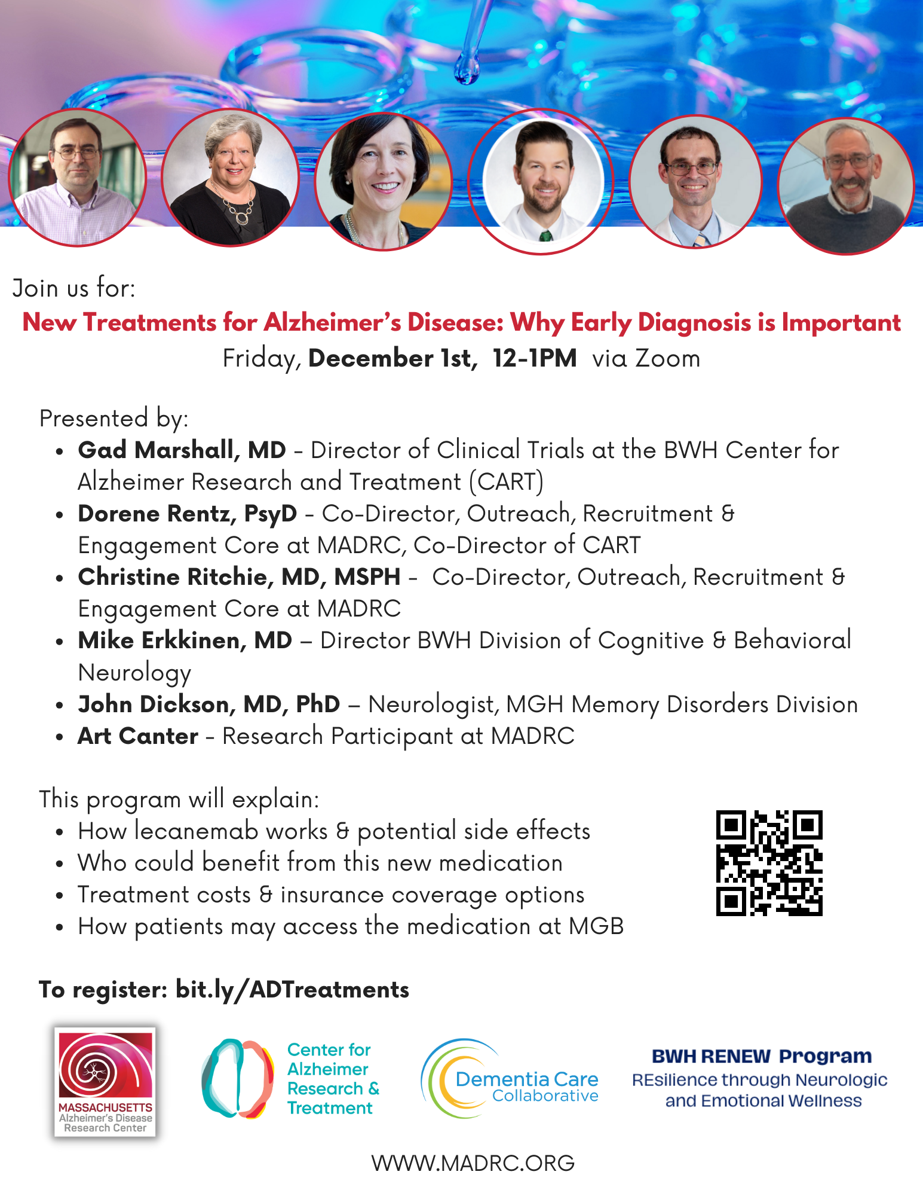
Welcome! We will start the program soon.
Today’s Panel:
* Gad Marshall, MD – Director of Clinical Trials at the BWH Center for Alzheimer Research and Treatment (CART)
* Dorene Rentz, PsyD – Co-Director, Outreach, Recruitment & Engagement Core at MADRC, Co-Director of CART
* Christine Ritchie, MD, MSPH – Co-Director, Outreach, Recruitment & Engagement Core at MADRC
• Mike Erkkinen, MD – Director BWH Division of Cognitive & Behavioral Neurology
• John Dickson, MD, PhD – Neurologist, MGH Memory Disorders Division
* Art Canter – Research Participant at MADRC
WWW.MADRC.ORG
1

Slide 2
WWW.MADRC.ORG
1

Slide 3
WWW.MADRC.ORG
1

Slide 4
WWW.MADRC.ORG
1

Slide 5
WWW.MADRC.ORG
1

Slide 6
WWW.MADRC.ORG
1

Slide 7
WWW.MADRC.ORG
1

Slide 8
WWW.MADRC.ORG
1

Slide 9
WWW.MADRC.ORG
1

Slide 10
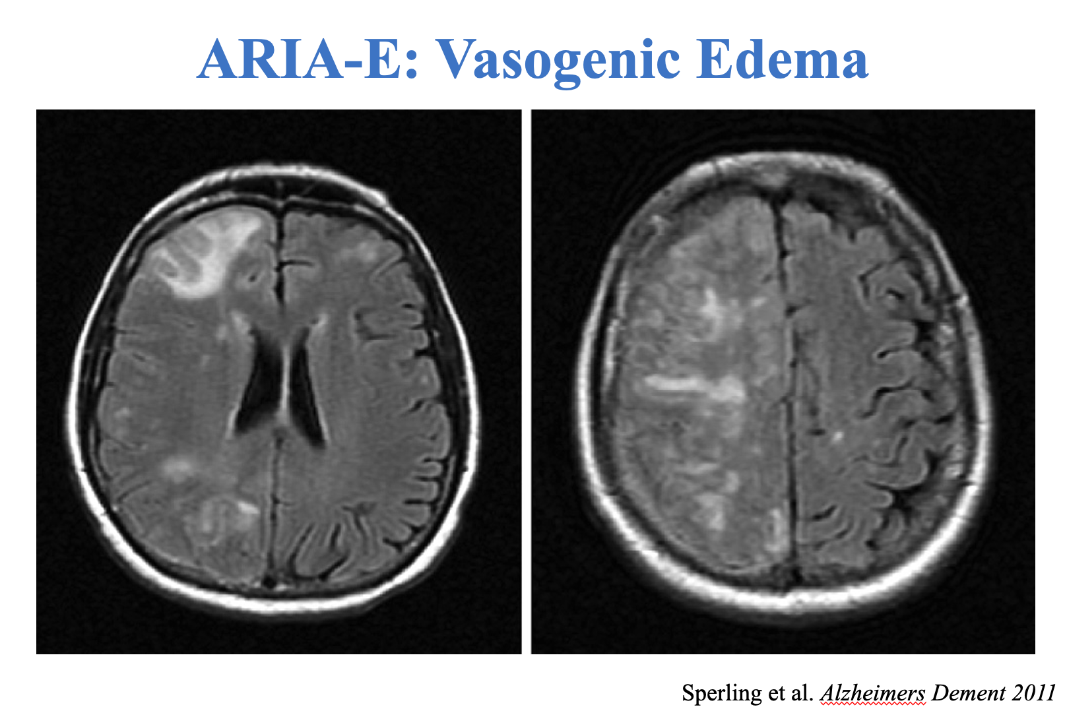
WWW.MADRC.ORG
1

Slide 11
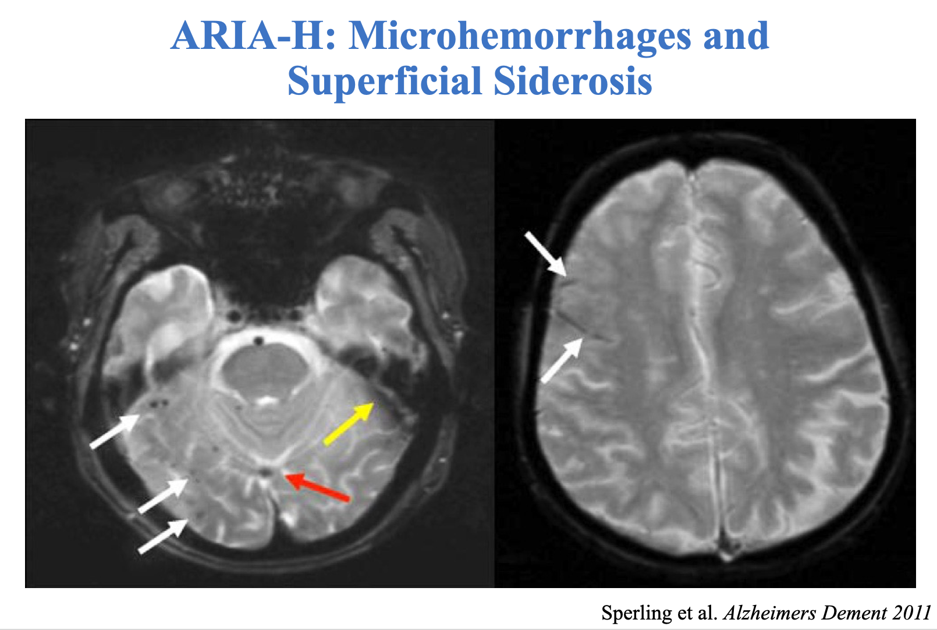
WWW.MADRC.ORG
1

Slide 12
WWW.MADRC.ORG
1

Slide 13
WWW.MADRC.ORG
1

Slide 14
WWW.MADRC.ORG
1

Slide 15
What people want from a treatment varies from person to person and depends on who you are talking to….
As a health care professional, I may want a treatment that improves brain health and has fewer side effects for persons living with dementia
As a patient, I may care about what a treatment can do to affect what I can do or how long I can live or how my life impacts my family
As a care partner, I may want a treatment tha t helps with sleep or lowers social isolation or increases what my loved one can do without my help
WWW.MADRC.ORG
1

Slide 16
When persons with dementia or their loved ones were asked what an ideal treatment for dementia would do for them, they said…
WWW.MADRC.ORG
1

Slide 17
With lecanemab, the decline in quality of life reported by the person with dementia and their study partner was slower then without lecanemab.
Even with lecanemab, quality of life declines over time.
WWW.MADRC.ORG
1

Slide 18
ARIA = Amyloid-Related Imaging Abnormalities
In treatments like lecanemab, about one-quarter to one-third have either ARIA related to brain swelling (edema) or ARIA related to bleeding in the brain (hemorrhage)
Of people who have one of these ARIA changes on their MRI, 1 in 5 have symptoms and 1 in 100 have severe or serious symptoms
WWW.MADRC.ORG
1
Notes:
Only 1 in 5 people who develop ARIA from lecanemab experience symptoms (most commonly headache, visual changes, and confusion).

Slide 19
WWW.MADRC.ORG
1

Slide 20
Questions to ask about new treatments like lecanemab
Is slowing of disease progression (a slower decline of quality of life (equal to a time savings of 6 months) on a brain test worth the cost and burden of treatment?
Do the changes we see make a difference over a longer period of time?
WWW.MADRC.ORG
1

Slide 21
A Family Members’ Perspective
WWW.MADRC.ORG
1

Slide 22
Issues to Consider…
Will what the treatment will do meet the expectations of the person considering treatment along with their family?
Does the peron considering treatment have risk factors that increase risk for bad side events?
Is the person considering treatment willing to assume the burden of every two-week infusions?
Is the person considering treatment willing to assume the additional costs of MRI monitoring and clinical visits?
Will the treatment work as effectively in persons who weren’t included in the original studies?
Will the treatment be equally effective in underrepresented minority populations?
WWW.MADRC.ORG
1

Slide 23
Mike Erkkinen, MD – Director BWH Division of Cognitive & Behavioral Neurology
John Dickson, MD, PhD – Neurologist, MGH Memory Disorders Division
WWW.MADRC.ORG
1

Slide 24
WWW.MADRC.ORG
1

Slide 25
WWW.MADRC.ORG
1

Slide 26
WWW.MADRC.ORG
1

Slide 27
WWW.MADRC.ORG
1

Slide 28
WWW.MADRC.ORG
1

Slide 29
WWW.MADRC.ORG
1

Slide 30
WWW.MADRC.ORG
1

Slide 31
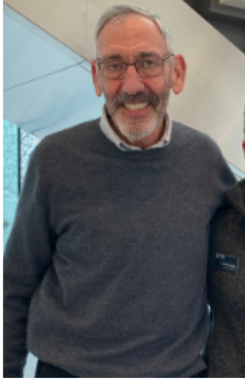
A Research Participants’ Perspective
Art Canter
WWW.MADRC.ORG
1

Slide 32
We value your feedback. Please take 5 minutes to respond to our post-event survey.
The link will be emailed to all registrants shortly.
WWW.MADRC.ORG
1

Slide 33
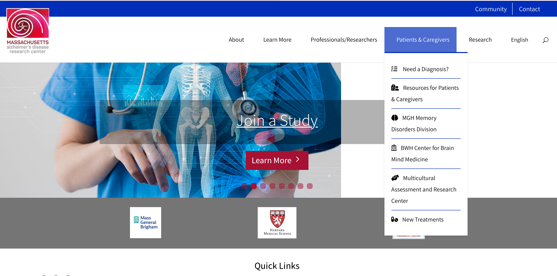
Please visit the MADRC website for more
helpful resources and information:
WWW.MADRC.ORG
WWW.MADRC.ORG
1

Slide 34
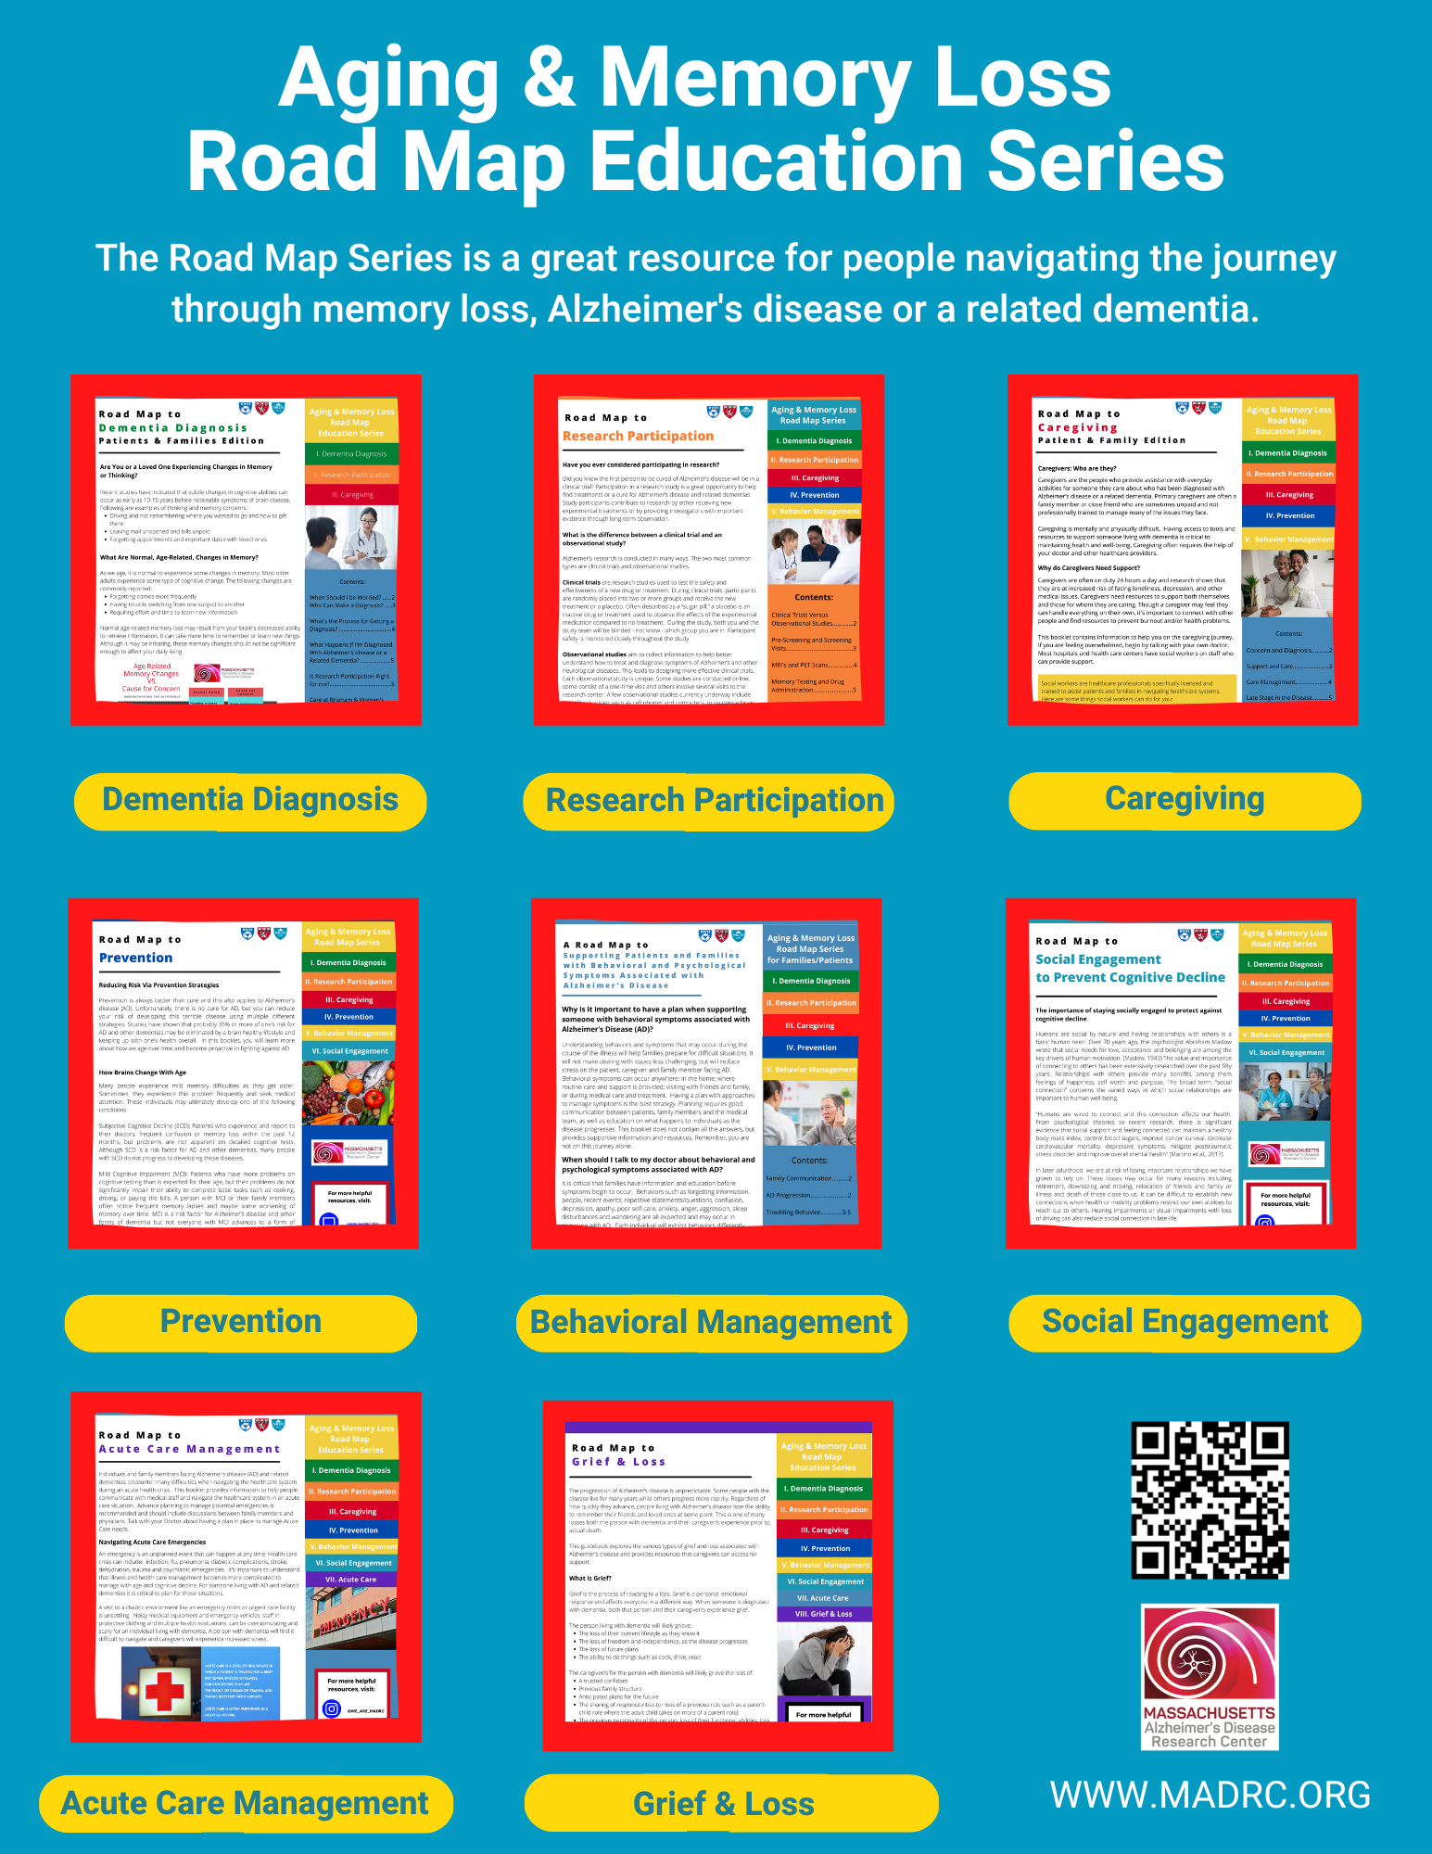
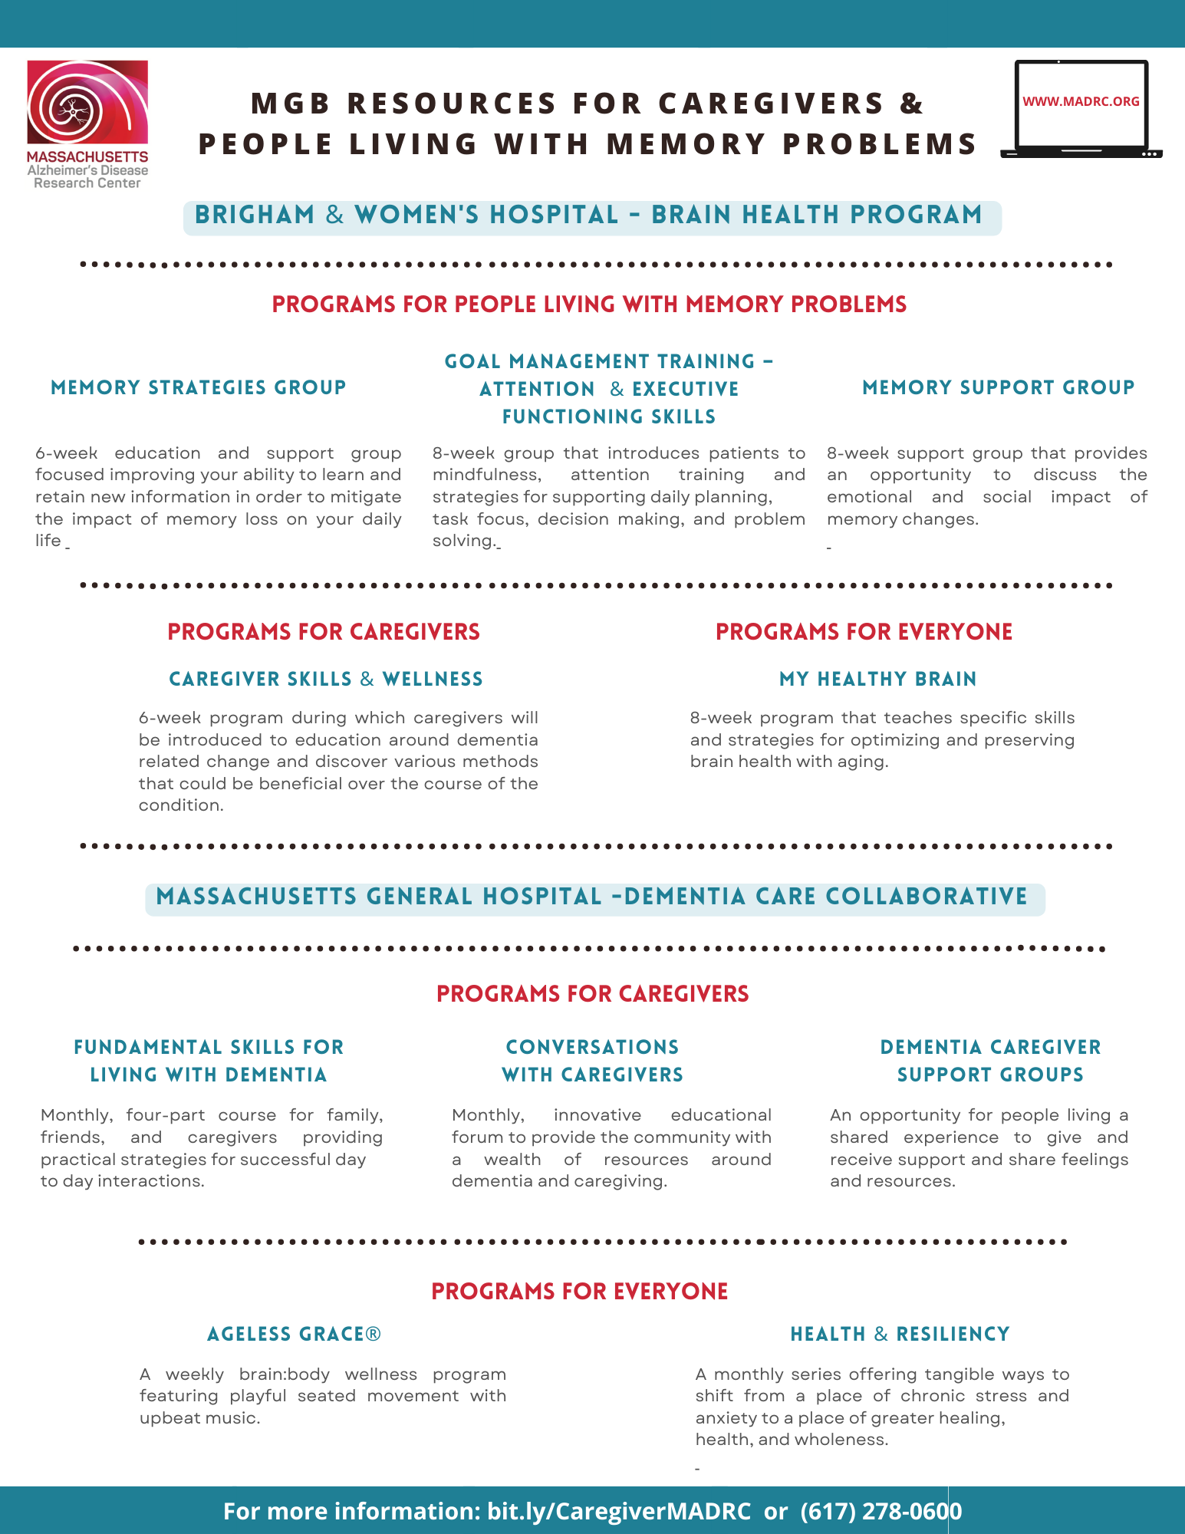
WWW.MADRC.ORG
1

Slide 35
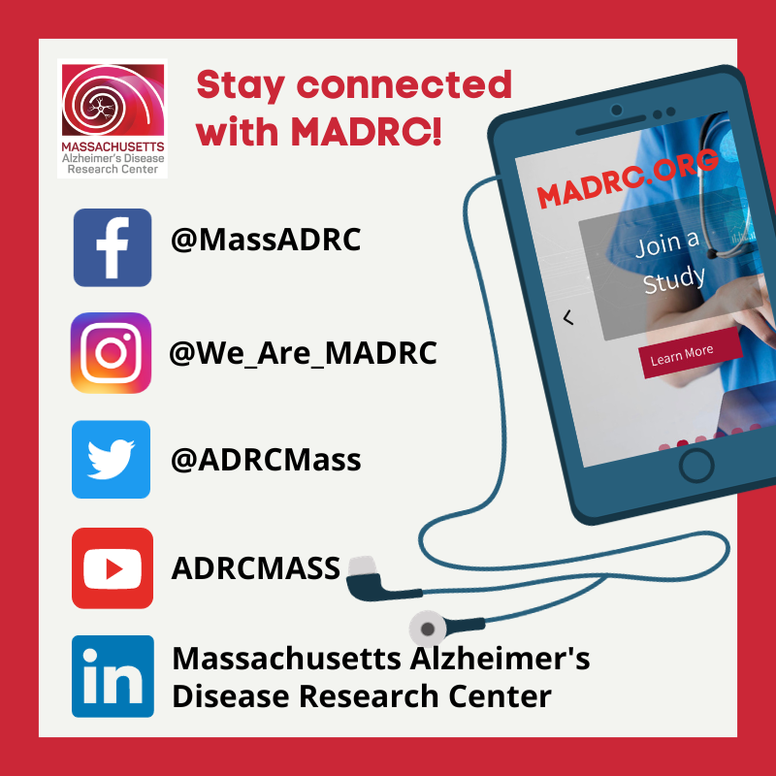
If you have questions or need additional information:
Email: bwhMADRCeducation@partners.org
Call: 617-278-0600
WWW.MADRC.ORG
1

Slide 36
WWW.MADRC.ORG
1

